Slide 1

-Prateek Gupta (EC23B016) ECE
Dead-Lock CMOS Circuit design using Cadence Virtuoso

Slide 2
ABSTRACT
The dead-lock circuit ensures that a control signal becomes permanently ‘1’ only after it is verified as a true, noise-free signal. It checks the input for several consecutive clock cycles, and only if the signal stays at logic ‘1’, the circuit outputs a ‘1’ and locks itself. After locking, the output remains ‘1’ until a reset is applied, preventing false triggering due to noise and ensuring stable operation of the control block.

Slide 3
What is the need of this circuit?
In power-gating systems, multiple PMOS switches are used to disconnect the core and reduce leakage.
Due to long-term NBTI effects, PMOS threshold voltage increases, causing higher voltage drop and reduced virtual supply to the core.
A monitoring circuit detects this drop and signals the control block to turn ON more PMOS switches in parallel to restore the voltage.

Slide 4
Problem Without Dead-Lock
When more switches turn ON, the virtual voltage recovers and the monitoring signal may immediately fall back to ‘0’.
This causes the system to switch repeatedly between single-switch and multi-switch operation, creating instability.
Role of the Dead-Lock Circuit
Once the monitoring block signals the need for multi-switch operation, the dead-lock circuit locks this signal until reset.
It also verifies the signal for multiple clock cycles to ensure it is not due to noise.
After locking, the output stays ‘1’ and unnecessary switching is stopped via clock gating, improving stability and power efficiency.

Slide 5





_{Clock}
Clock Gated
Monitoring Circuit
_{Sleep}
Dead-Lock Circuit
Control Unit
Power Switches
_{Virtual VDD}
Core
Power Gating Circuit With Dead lock

Slide 6
INDRODUCTION
In this work, a dead-lock verification circuit is designed to validate an input signal by checking it over four consecutive clock cycles. The circuit is implemented using an FSM-based digital logic structure built with D flip-flops. The complete design, simulation, and analysis were carried out in Cadence Virtuoso using the SCL 180 nm PDK. The functionality of the circuit is fully verified, and a complete custom layout has also been developed.

Slide 7
THEORY & WORKING
The dead-lock circuit is designed using a 4-state FSM: 00 → 01 → 10 → 11
Two D flip-flops are used to generate these four states.
The circuit checks whether the input stays logic 1 for four consecutive clock cycles.
When all three nets (input , 2-bits state) become logic ‘1’, output => 1
For Reset two 2:1 mux (TG) is used with two flop to forcefully change the states from [11 → 00].
When output become logic ‘1’ , it will off the clock across the flops to stop further state changes, which reduces power consumption and chance of error.

Slide 8
State Transition Table
Present State | Input | Next State | Output
00 | 0 | 00 | 0
00 | 1 | 01 | 0
01 | 0 | 00 | 0
01 | 1 | 10 | 0
10 | 0 | 00 | 0
10 | 1 | 11 | 0
11 | 0 | 11 (Locked) | 1
11 | 1 | 11 (Locked) | 1

Slide 9
Boolean Logic
The First flop (LSB) with input (D0) and output (Q0)
The Second flop (MSB) with input (D1) and output (Q1)
The output of Dead – lock is the AND (Q1, Q0), and of output of both D flop. Out = (Q1 . Q0)
The input of LSB flop D0 -:
D0 = (~Q0 . In ) + out
The input of MSB flop D1 -:
D1 = ((Q0 XOR Q1) . In) + out
The Clock input -:
clk = ~out . CLK_in

Slide 10
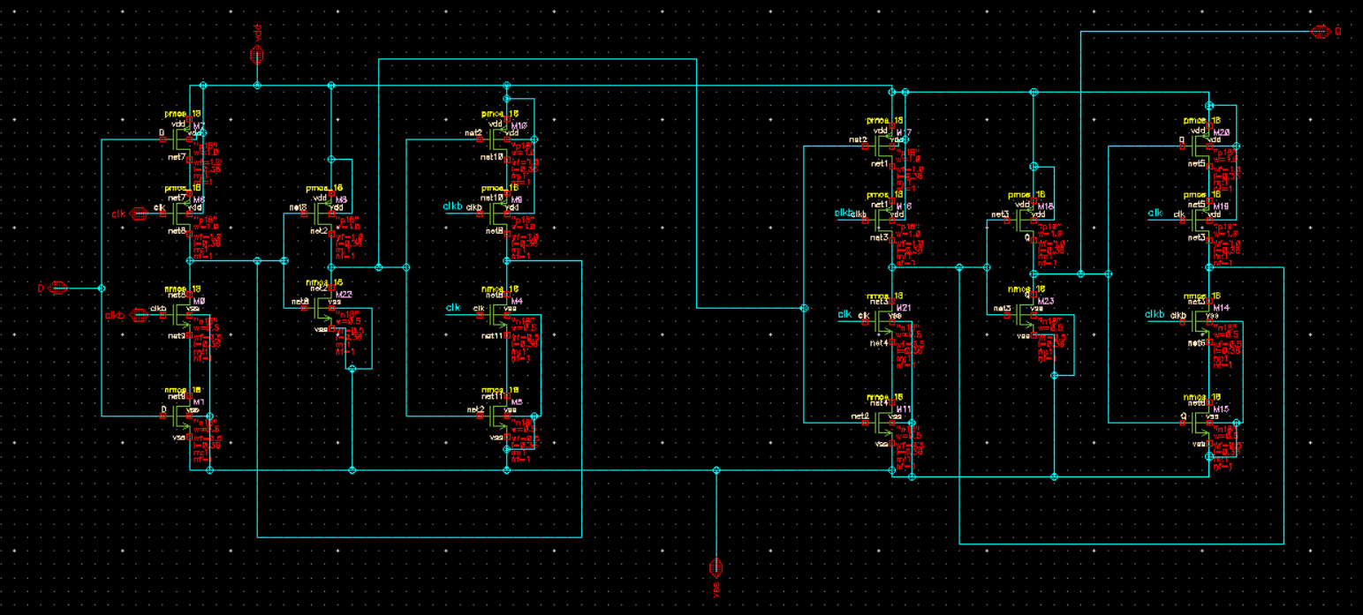
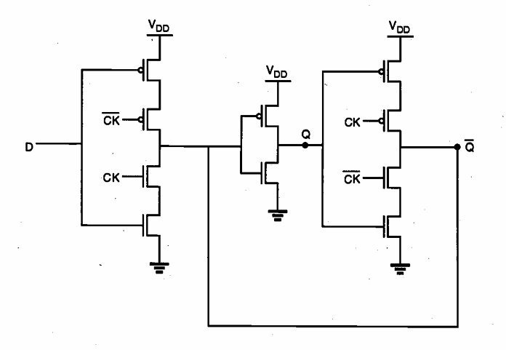
D-Flip Flop Design & Layout
This Master-slave D flip flop is made by using two D latch back to back, front latch (negative) connected with back latch (positive)
Each latch has a total of 10 transistors (5 – PMOS, 5 - NMOS)
D- Latch
D - Flipflop

Slide 11
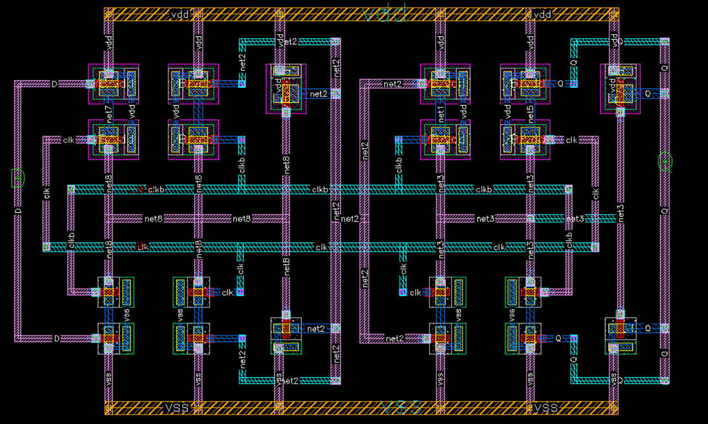
Layout

Slide 12
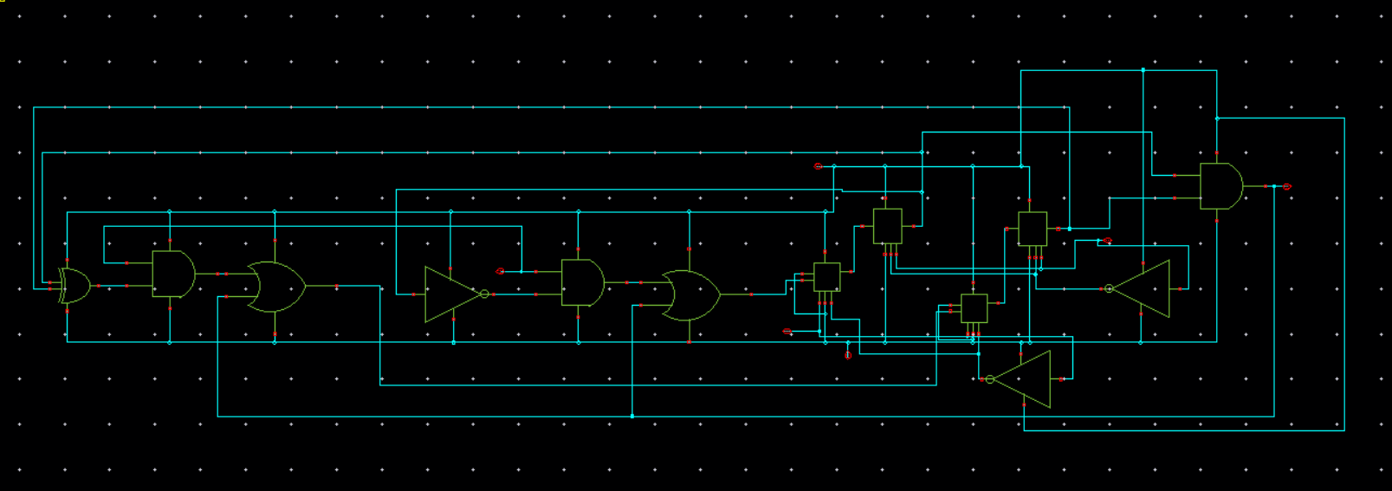
Dead-Lock Design & Layout
This is the implementation of FSM logic using basic gates and Flops
Dead-lock without clock gating

Slide 13
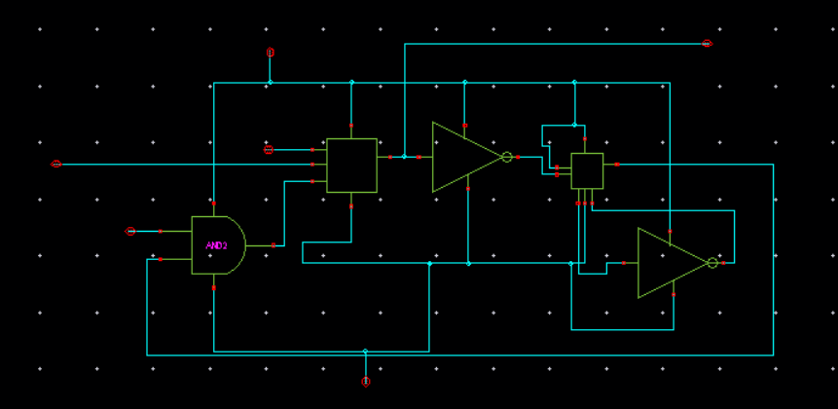
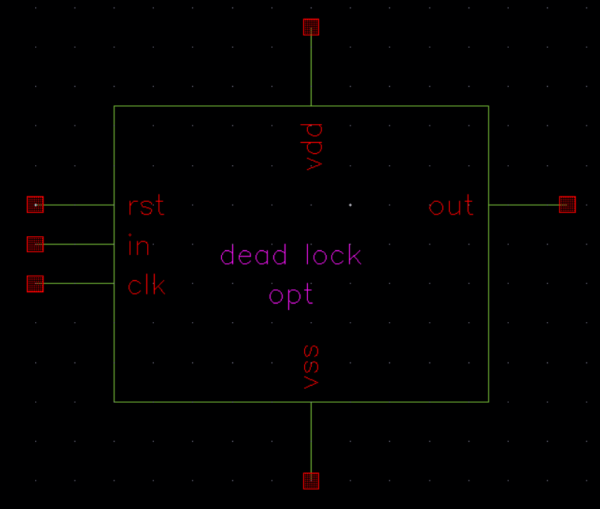
Complete Dead- lock design with Clock gating :-
Here a simple 2:1 Mux with inverted output logic with a AND gate is used to Disconnect Clock with Dead-lock after output lock at logic ‘1’, and the reset is given to revert the lock and reconnect the clock.
Final Symbol Design of Dead – lock :-
This is the complete block level symbol of my dead- lock design in which
Vdd -: Power supply
Vss -: Ground (gnd)
Clk -: clock input
In -: output of any monitoring circuit
Rst -: Reset input

Slide 14
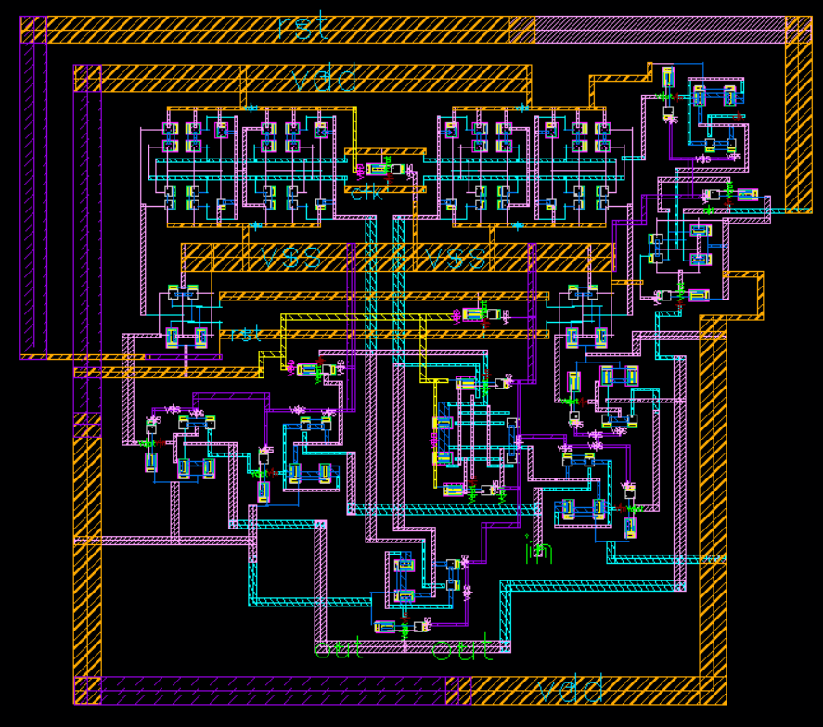
Final Layout

Slide 15
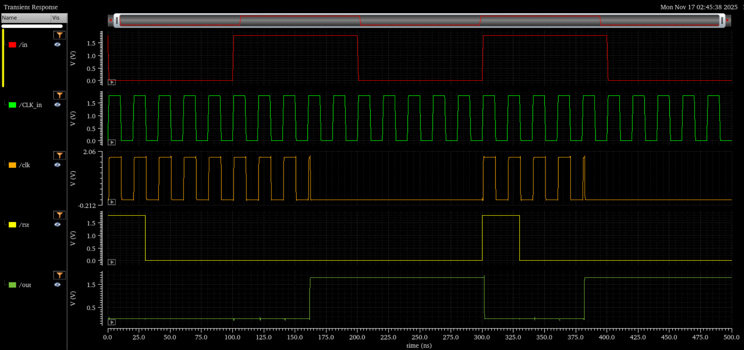
Output & Simulation

Slide 16
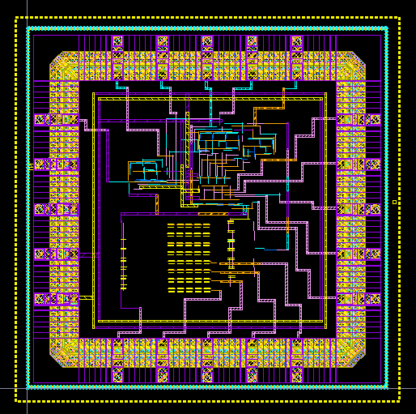
Layout of Power Gating Circuit with Dead lock
Dead lock

